Slide 1

Popular
Music
Over Time
Ananya Subramaniam and Sree Lasya Gogineni

Slide 2
Goal
Mode of Collection
Observation and Measurement
Existing datasets
  Kaggle - Spotify Tracks Dataset
  Kaggle - Billboard Hot 100
  Github Repo by mhollingshead - Historic Billboard Hot 100 Data
“To what extent have the characteristics of popular songs changed over time?”
Understand trends in pop music
Compare songs across decades (1965 to 2025)

Slide 3
Data Acquisition
Problems
Lessons Learned
01
02
03
JSON and CSV
Joined Spotify Tracks Kaggle Dataset and Billboard Hot 100 Kaggle dataset based on track_name and artists
New dataset joined with Historic Billboard Hot 100 Data Github Repo on track_name, artist, and date
Initially - we had only a limited number of songs per year, with the maximum being 42 songs
Debugging led to seeing that artists were listed differently across the data sets
  “Taylor; Zayn” vs “Taylor & Zayn” vs “Taylor”
Important to match up the data columns and see how the values are stored before joining datasets together
Would’ve skewed our data and our analysis
Notes:
ananya

Slide 4
Organization
Metadata
New table - new key → track_name, artist, and date
Column names are descriptive
Original datasets have definitions for cross-verification
Background song info - danceability, duration, time, energy, valence, and tempo
Traceable from the original datasets

Slide 5
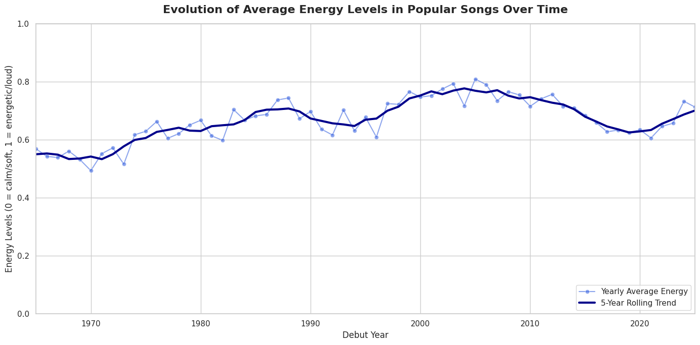
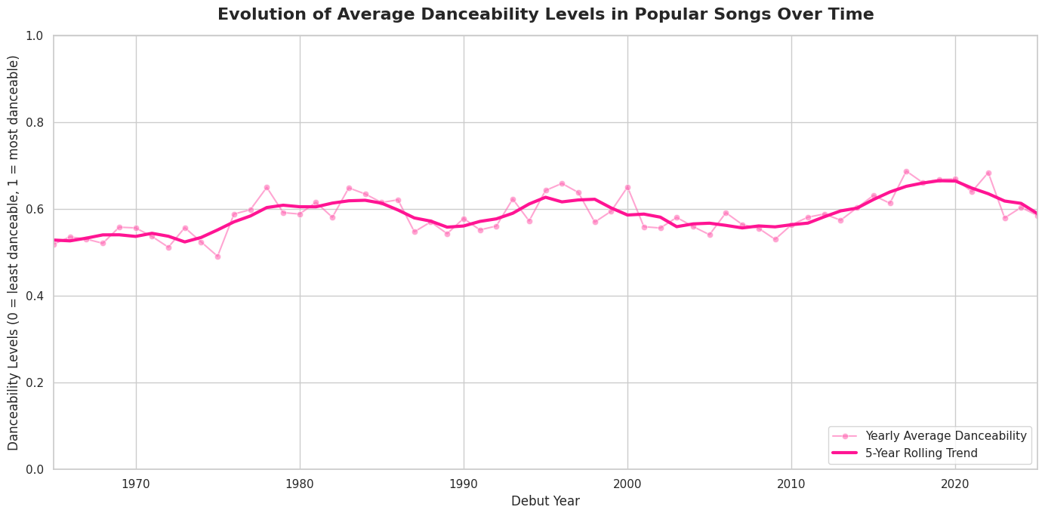
Energy vs Time
Danceability vs Time

Slide 6
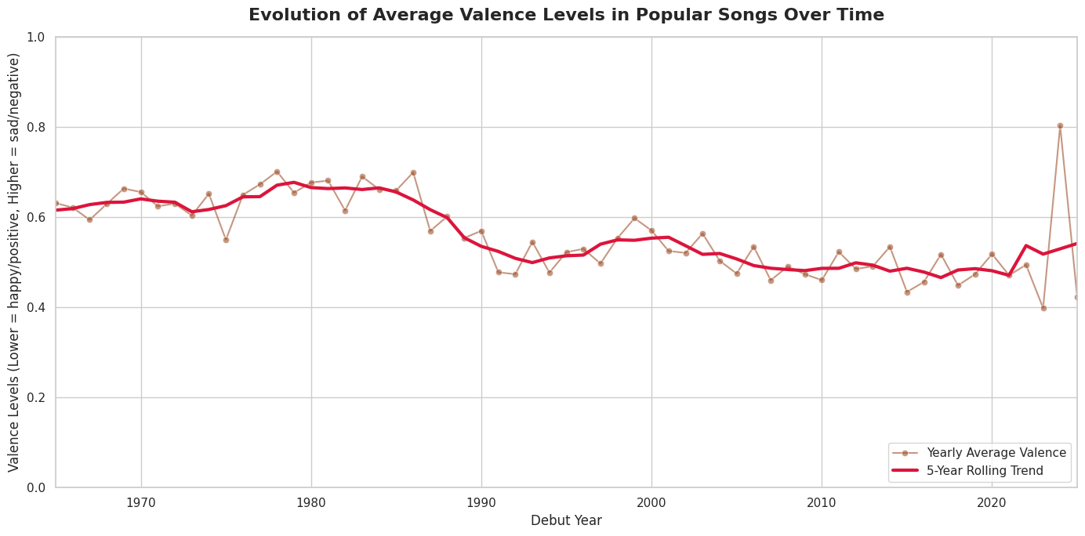
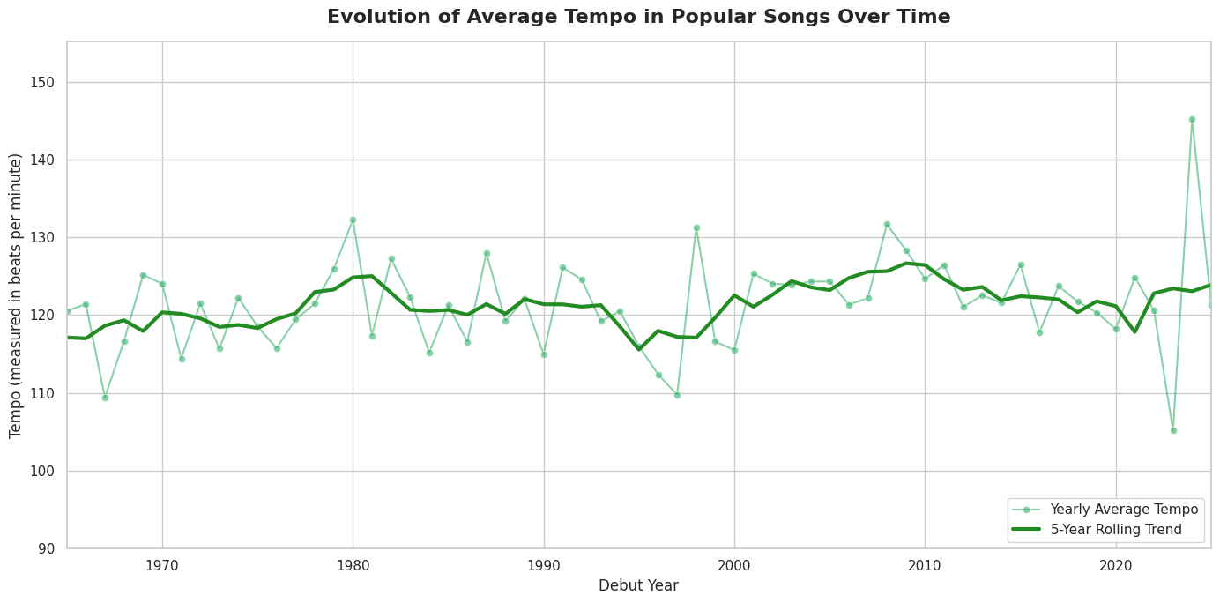
Valence vs Time
Tempo vs Time
Valence = mood of the song
Measured in BPM

Slide 7
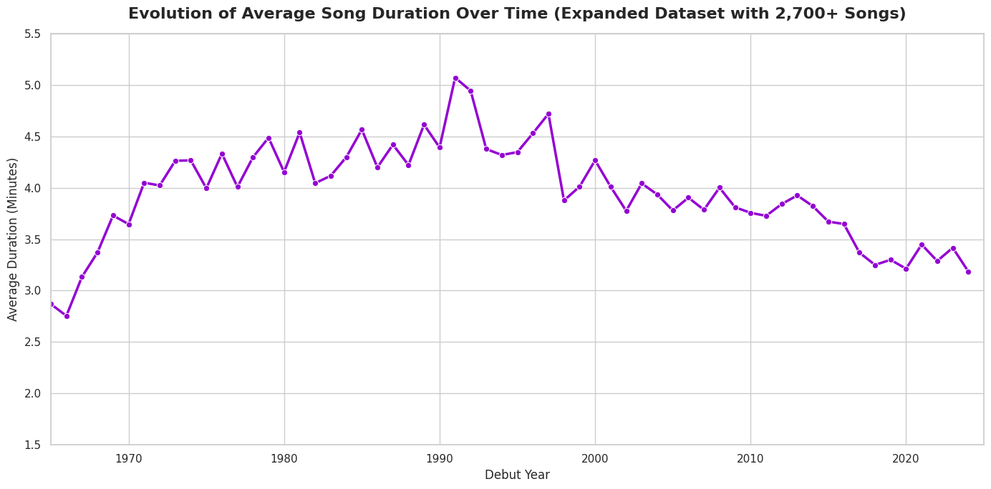
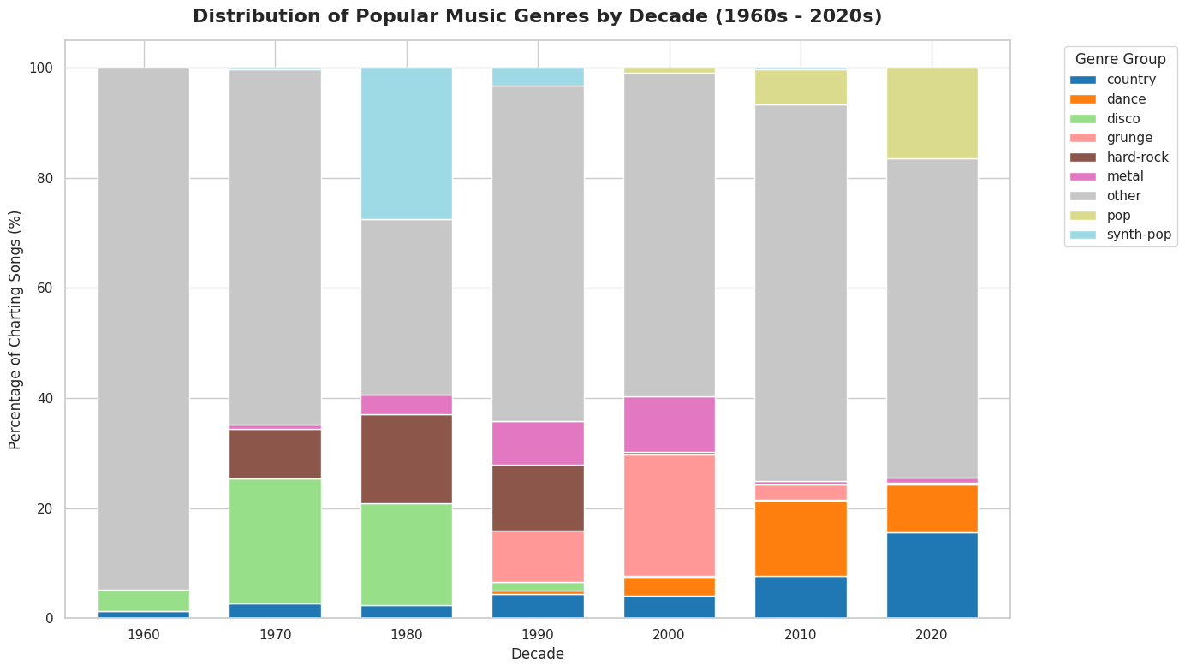
Duration vs Time
Genre By The Years

